Slide 1
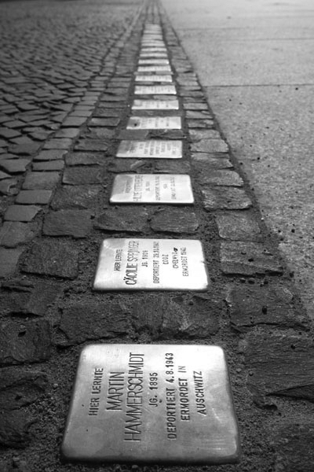
Stumbling to Remember Lessons from Germany’s Remembrance Culture

Slide 2
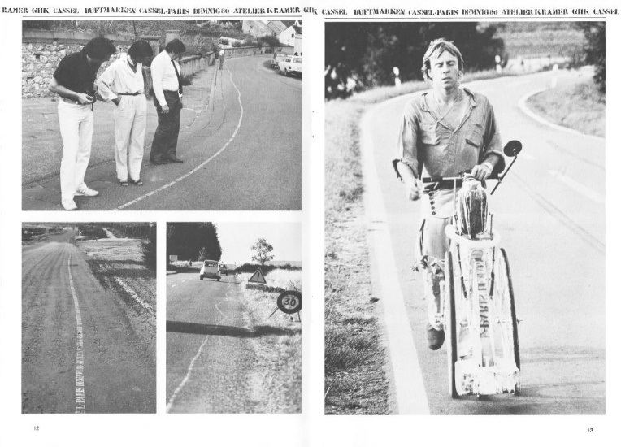
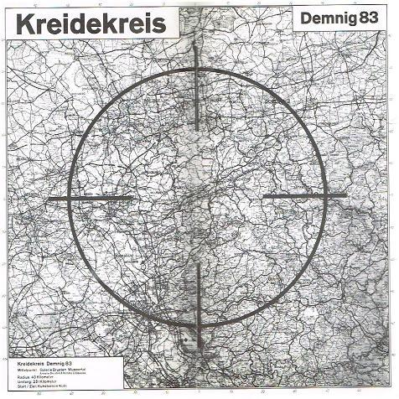
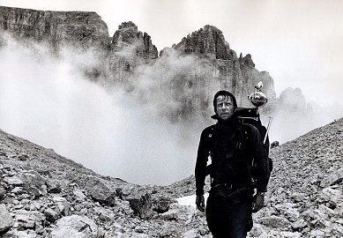
Gunter Demnig: The Evolution of An Idea
Duftmarken - drawing a line / Kassel to Paris (1980) / art, world records, publicity
Blutspur - drawing a line / Kassel to London (1981) / war crimes
Ariadne Faden - laying a thread / Kassel to Venice (1982) / epistemological thread
Kassel - Zehntausend Tote – drawing a circle around Kassel (1983) / WWII
Kreidekreis - drawing a circle around Wuppertal (1983) / nuclear destruction

Slide 3
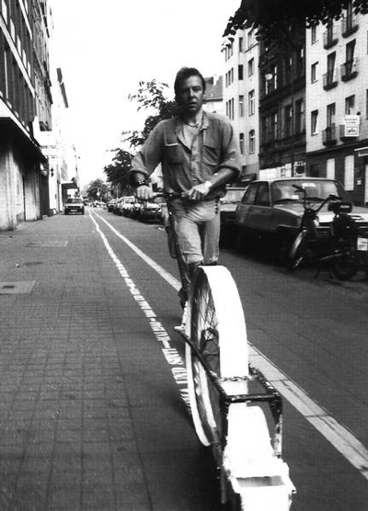
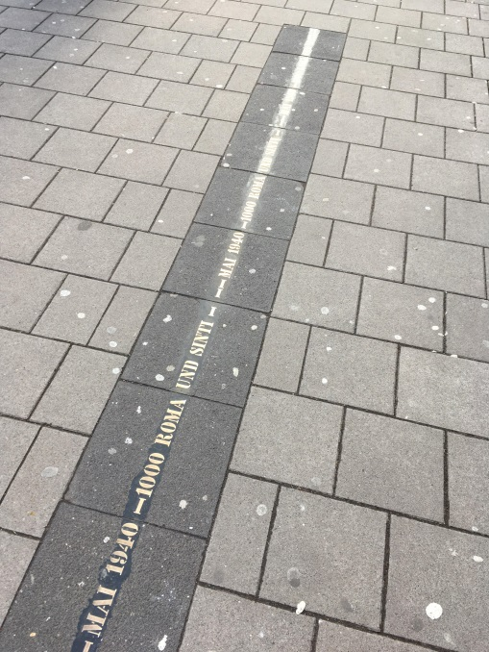
Drawing a Line through Cologne, Germany
“MAI 1940 - 1000 ROMA UND SINTI”
painted traces (1990)
metal traces (1993)
“It’s very nice what you are doing here, but Gypsies never lived in our neighborhood.”
(This comment by an unidentified woman in Cologne about the metal traces inspired Projekt Stolperstein)

Slide 4
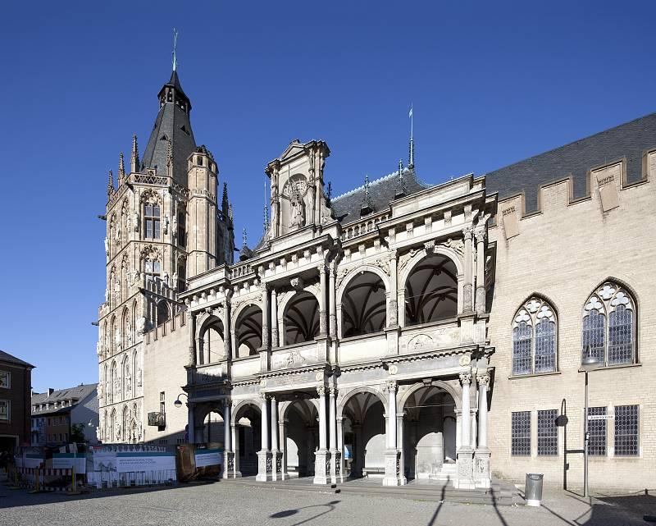
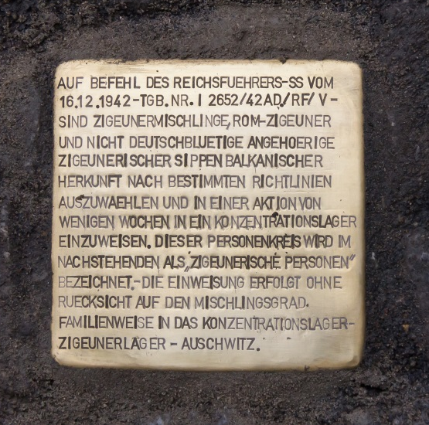
Responding to Bureaucratic Hurdles
The first Stolperstein
(December 1992)
(installed without permit to protest the city’s reluctance to support metal traces)
Historic court house in Cologne

Slide 5
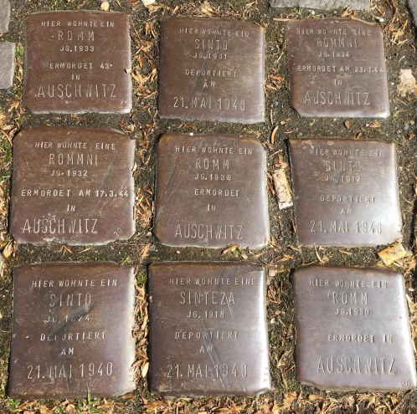
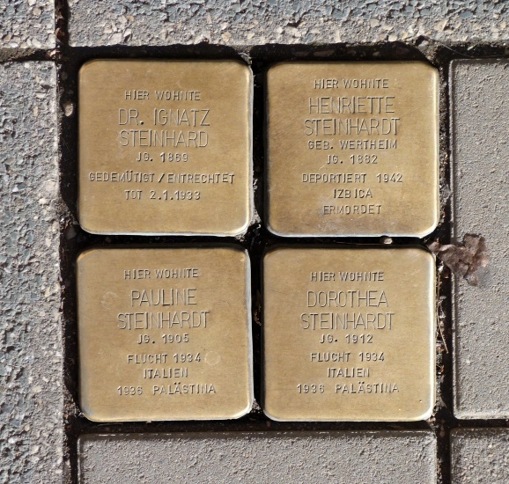
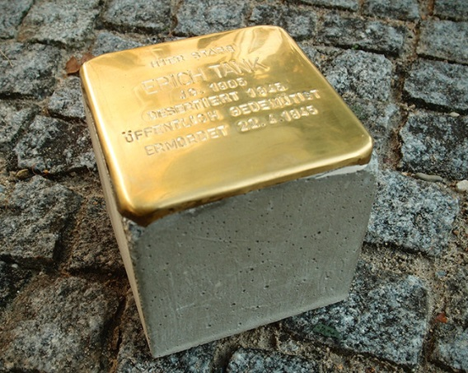
The Birth of Projekt Stolperstein (Stumbling Stone)
Projekt Stolperstein - “Größenwahn – Kunstprojekt für Europa”, international book fair, Frankfurt, 1993
Stolpersteine - Spuren gegen das Vergessen - Exhibit of about 250 Stolpersteine in the Antoniter Church in Cologne, 1994
Hier Wohnte – Photo exhibits throughout Germany, 1994 – 2000
(see next slide)
Placement of Stolpersteine in Cologne (1995) and in Berlin (1996)
(without permit / first sanctioned installations started in the year 2000)
Each Stolperstein is 10x10x10 cm
Unnamed Roma and Sinti
Ignatz, Henriette, Pauline & Dorothea

Slide 6
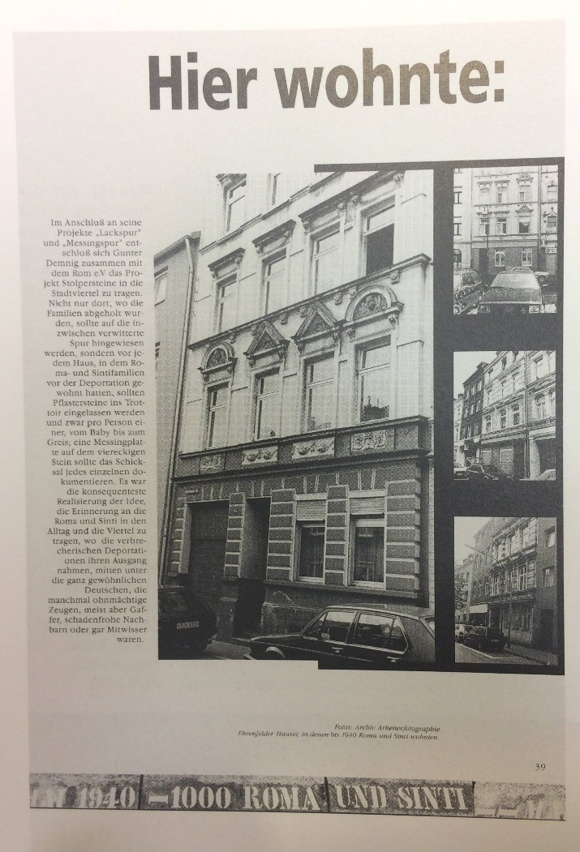
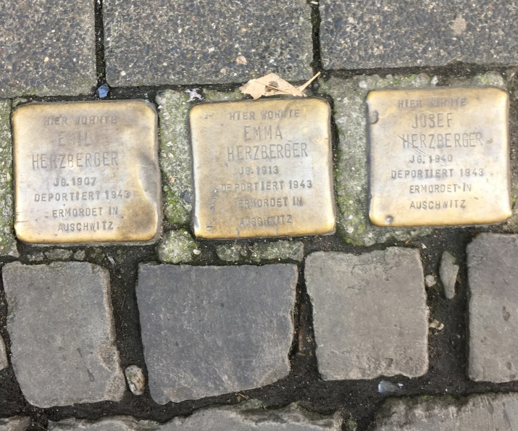
Hier Wohnte (Here Lived)
Before Stolpersteine were officially sanctioned, photo exhibits prepared the ground for what would become the largest, decentralized example of collective memorialization. (Stolpersteine installed in the 1990s were retroactively permitted.)
Emil, Emma & Josef

Slide 7
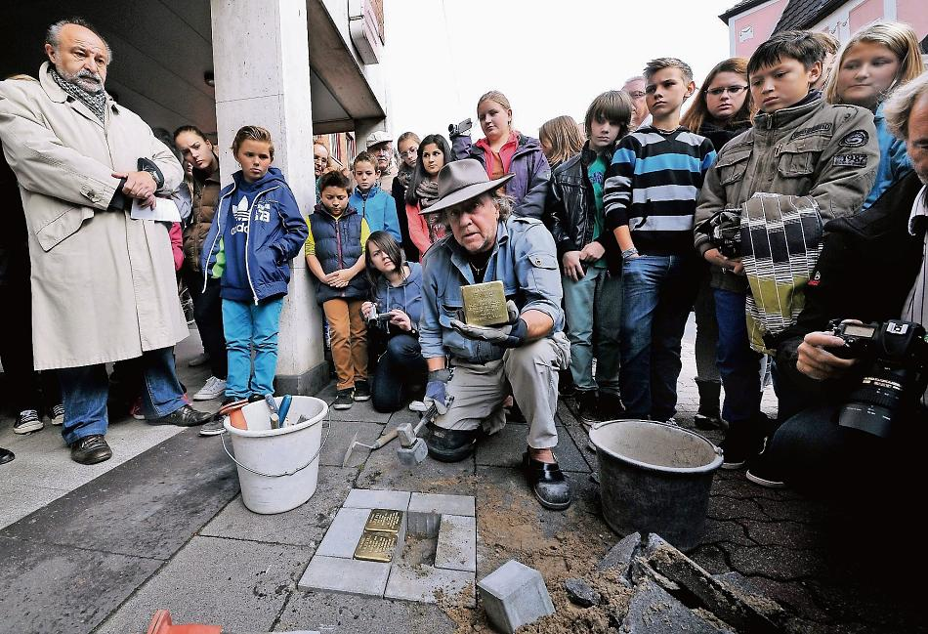
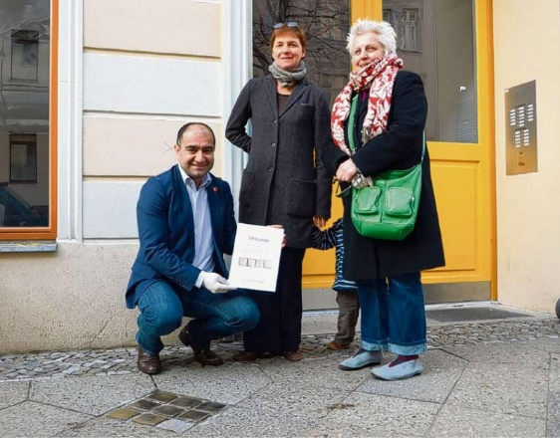
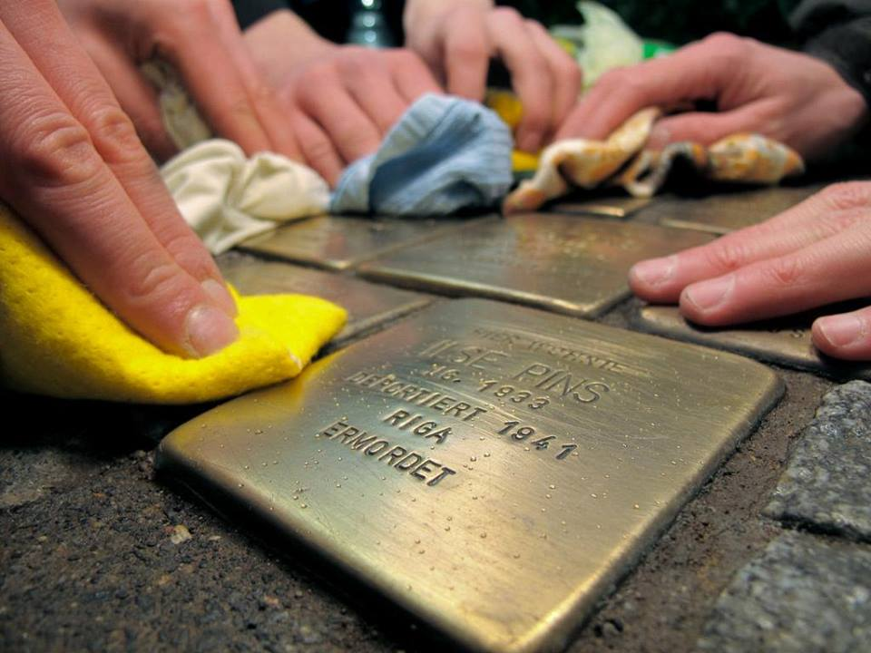
Stolpersteine: Research, Sponsorships & Schools
Starting with the year 2000, Demnig installs permitted Stolpersteine in public sidewalks in front of former residences of Nazi regime victims.
Research about victims is typically done by descendants, neighborhood associations and particularly schools.
A Stolperstein costs about $150 and is financed through Patenschaften or sponsorships. Cities receive Stolpersteine as gifts from sponsors.
Putzpatenschaften (cleaning sponsorships) take care of the maintenance.
Installation ceremonies of Stolpersteine are well publicized.
Very popular project despite some opposition by homeowners and cities.

Slide 8
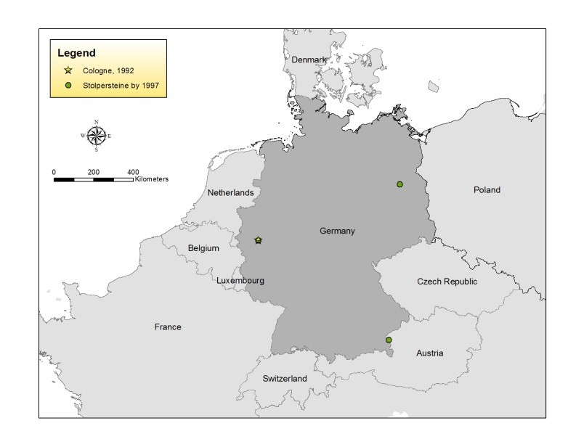
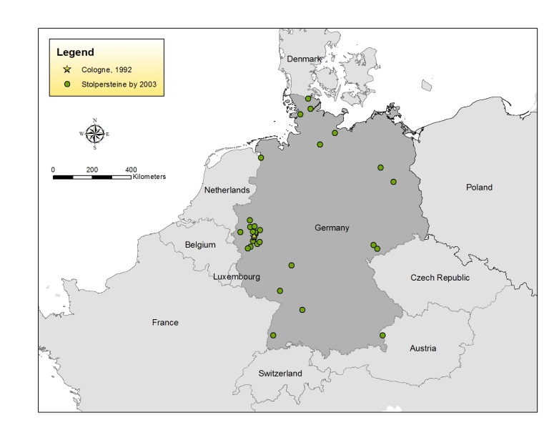
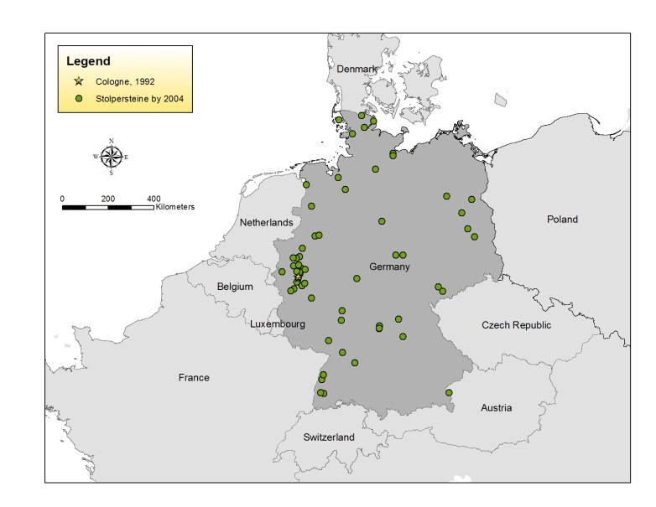
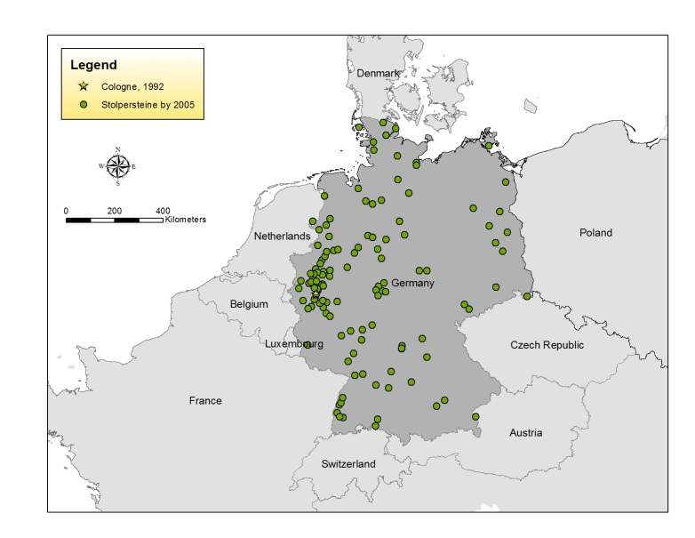
Diffusion of Stolpersteine in Germany
Although Projekt Stolperstein started in Cologne in 1992, which now has > 2,100 Stolpersteine, the cities of Berlin and Hamburg are leading the pack with > 8,300 and > 5,600 Stolpersteine respectively.

Slide 9
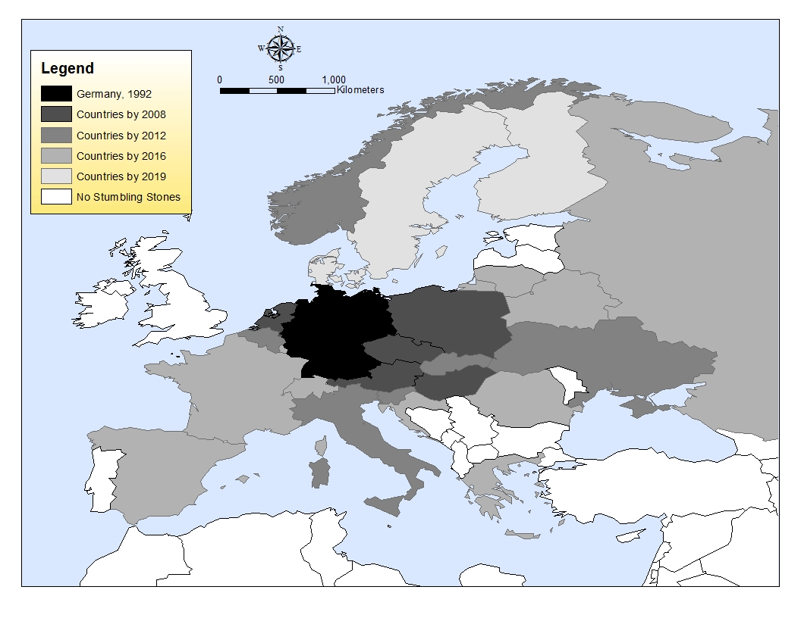
Diffusion of Stolpersteine in Europe
Today more than 80,000 Stolpersteine have been placed into the sidewalks of approximately 1,200 towns in 25 different countries, making it the most successful memorial of its kind.
Germany (1992); Austria (1997); Netherlands (2007); Hungary (2007); Czech Republic (2008); Poland (2008); Belgium (2009); Ukraine (2009); Italy (2010); Norway (2011); Slovakia (2012); Slovenia (2012); France (2013); Croatia (2013); Luxembourg (2013); Russia (2013); Switzerland (2013); Romania (2014); Greece (2015); Spain (2015); Lithuania (2016); Belarus (2016); Finland (2018); Denmark (2019); Sweden (2019).

Slide 10
Groups of Victims Identified on Stolpersteine
(after Hesse, 2017)
 | Cologne | Frankfurt | Regensburg | Essen | Solingen
Jewish | 89% | 94% | 87% | 86% | 60%
Sinti & Roma | 6% | < 1% | 2% | 3% | no information
Political | 3% | 3% | 10% | 7% | 34%
Homosexual | 1% | < 1% | no information | 1% | no information
Jehovah’s W. | < 1% | 1% | < 1% | 1% | 1%
Others* | < 1% | < 1% | < 1% | 2% | 5%
* Forced labor, victims of “euthanasia”, deserters, anti-war activists, suicides, refugees.
The majority of victims died in the Holocaust, but survivors are also identified.

Slide 11
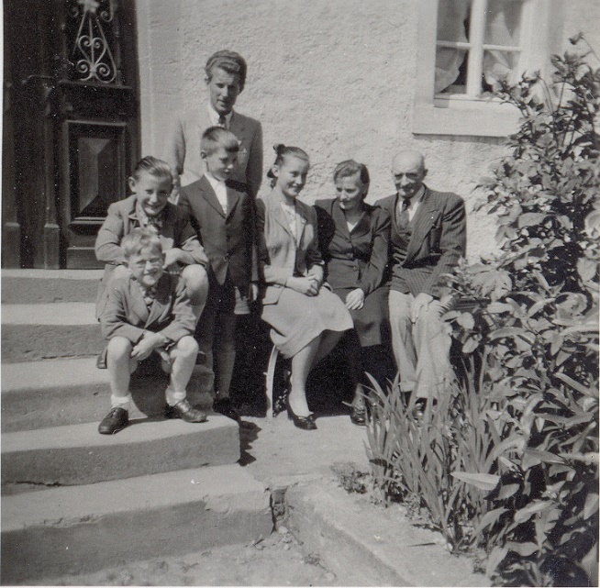
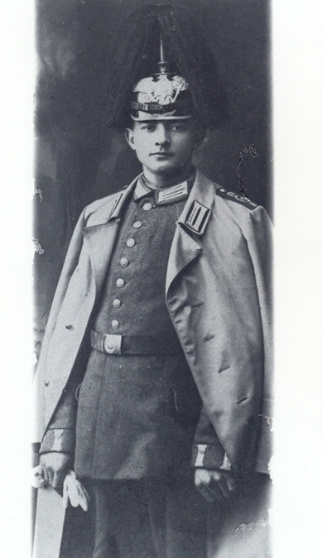
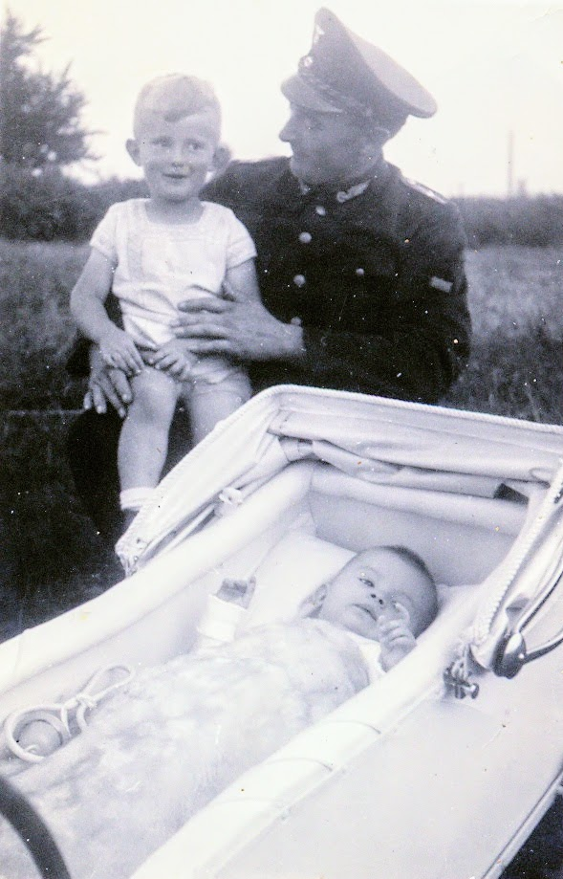
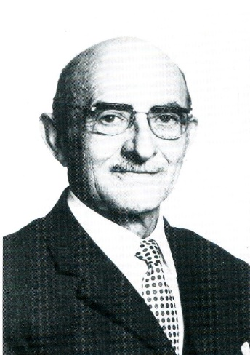
Peter Hümmerich (1897-1975) and his family
1953
1916
1936
1971

Slide 12
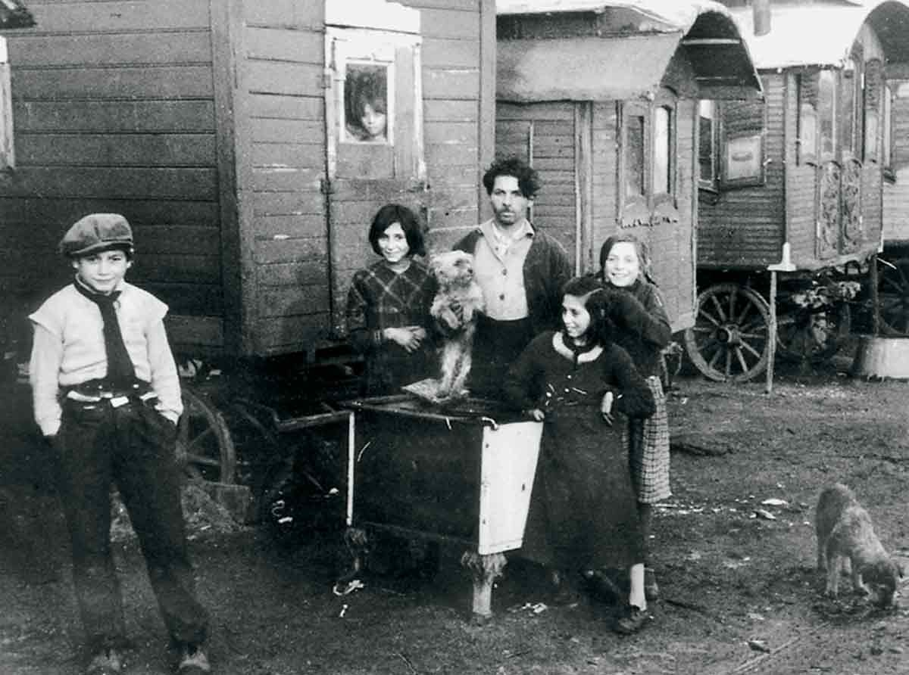
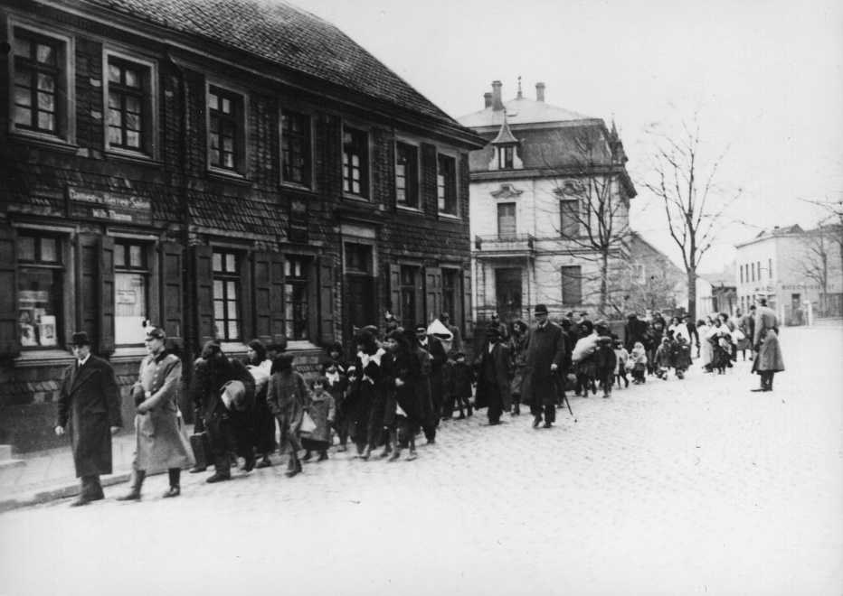
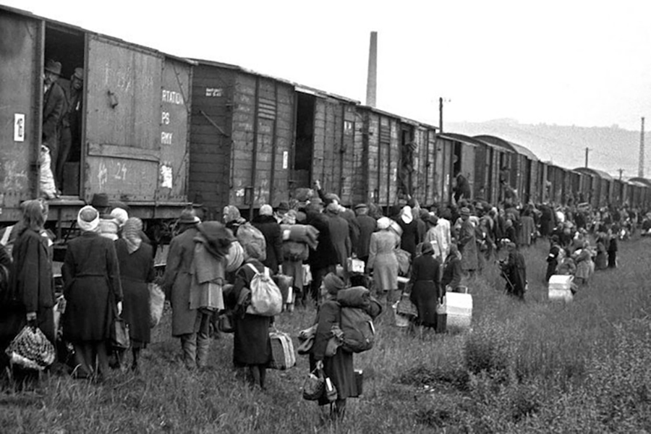
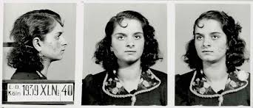
Deportation of Cologne’s Roma and Sinti

Slide 13
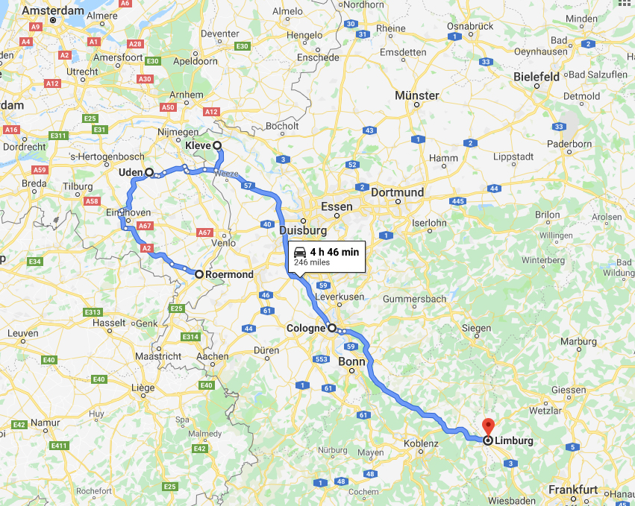
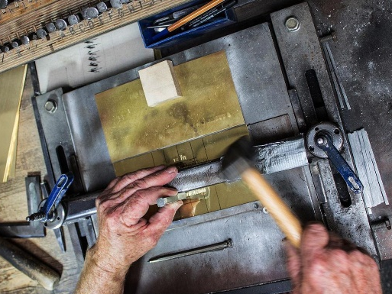
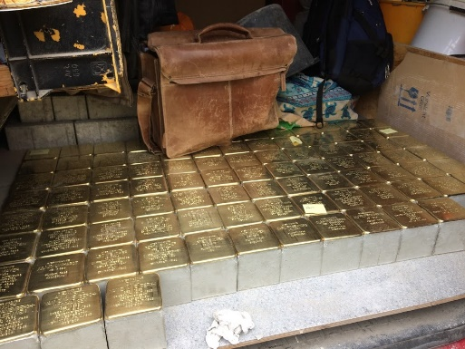
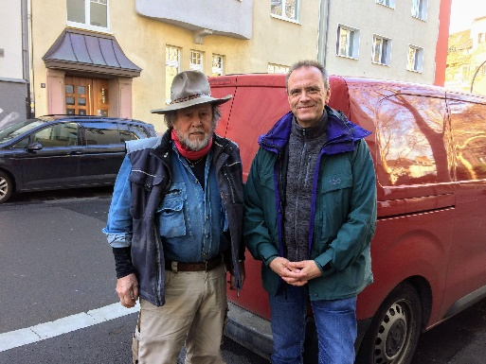
Traveling with Gunter Demnig (Netherlands & Germany / March 15-20, 2019)

Slide 14
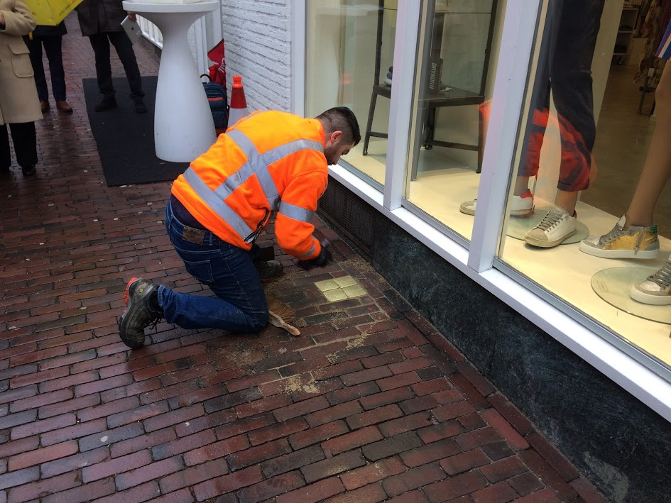
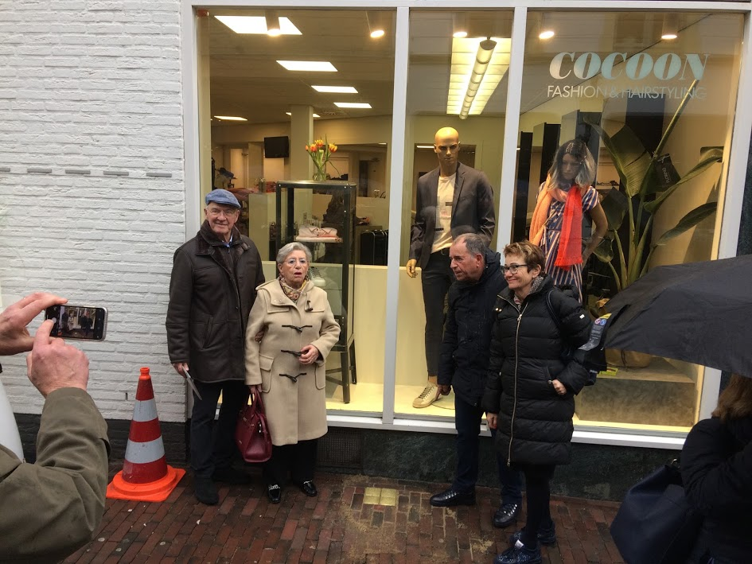
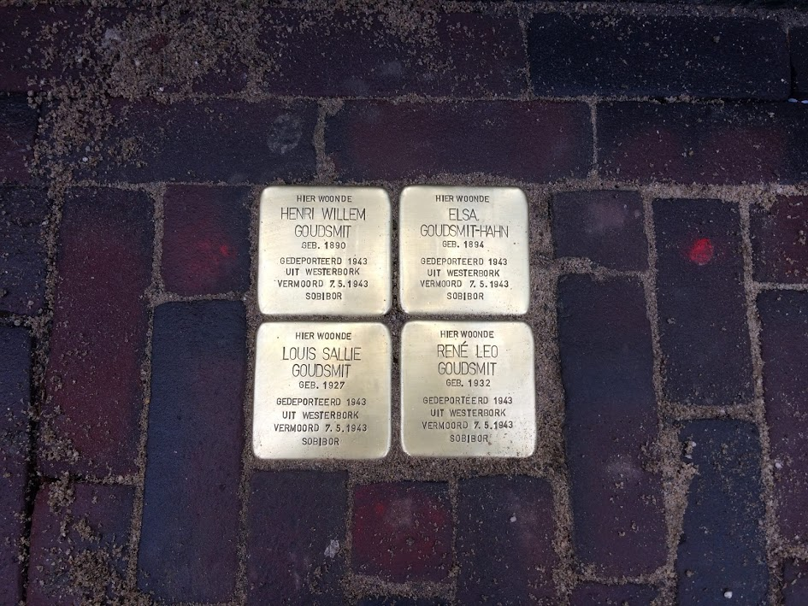
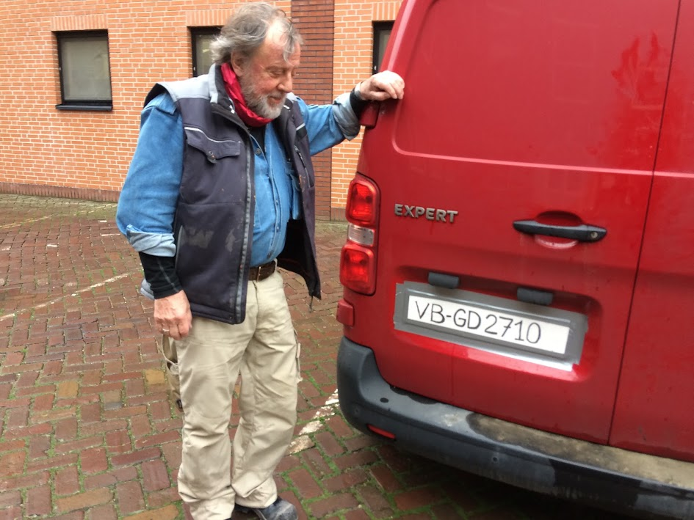
March 15: Roermond, Netherlands (25 stumbling stones were installed, but without Gunter Demnig. Why?)

Slide 15
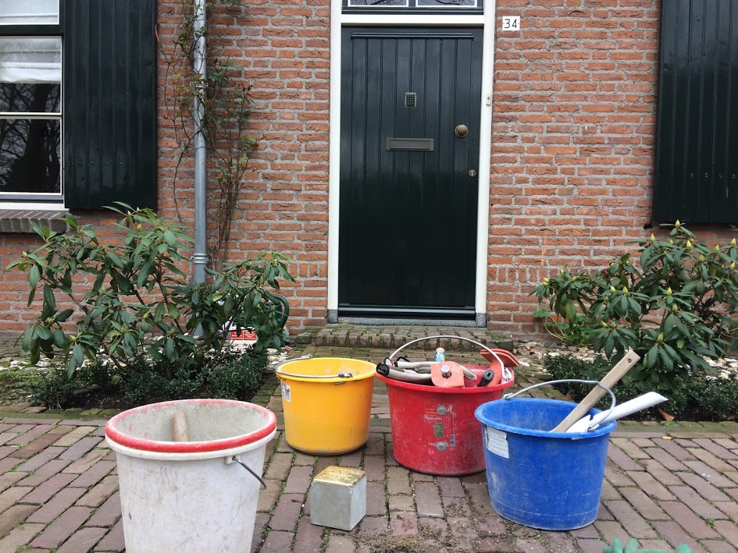
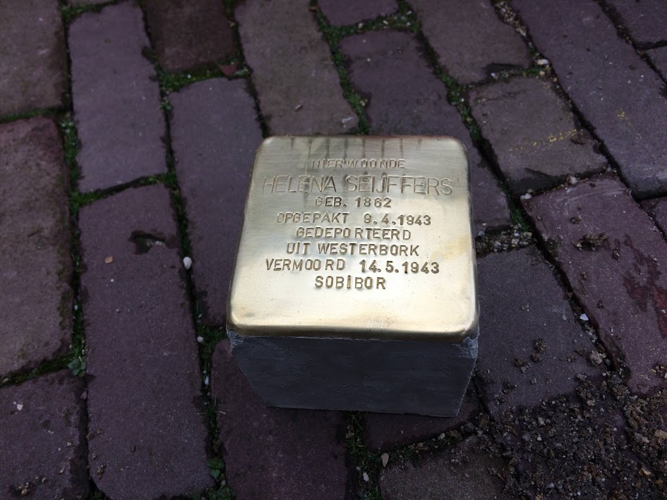
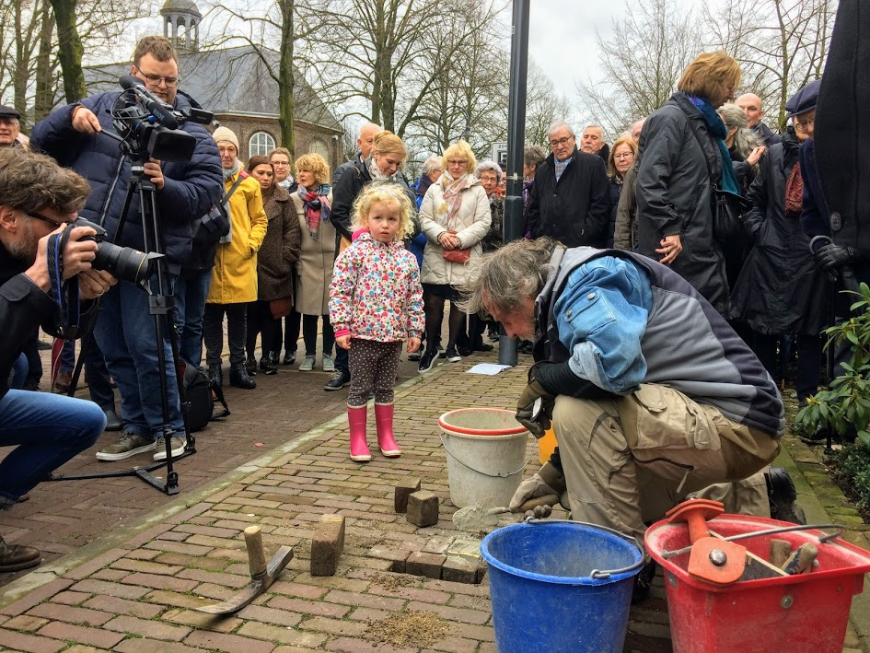
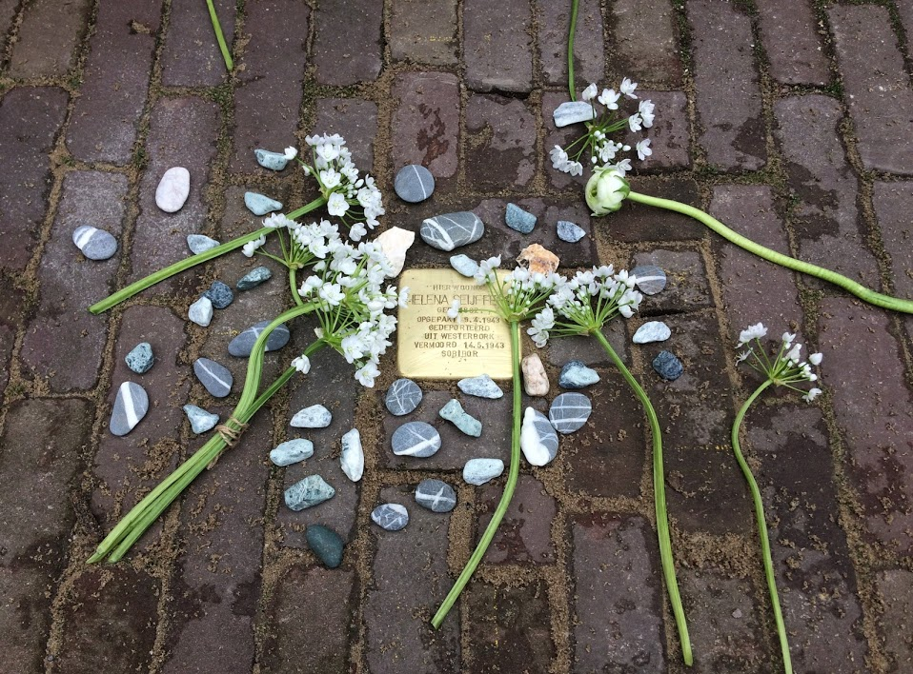
March 16: Uden, Netherlands (One stumbling stone was installed, the first in Uden.)

Slide 16
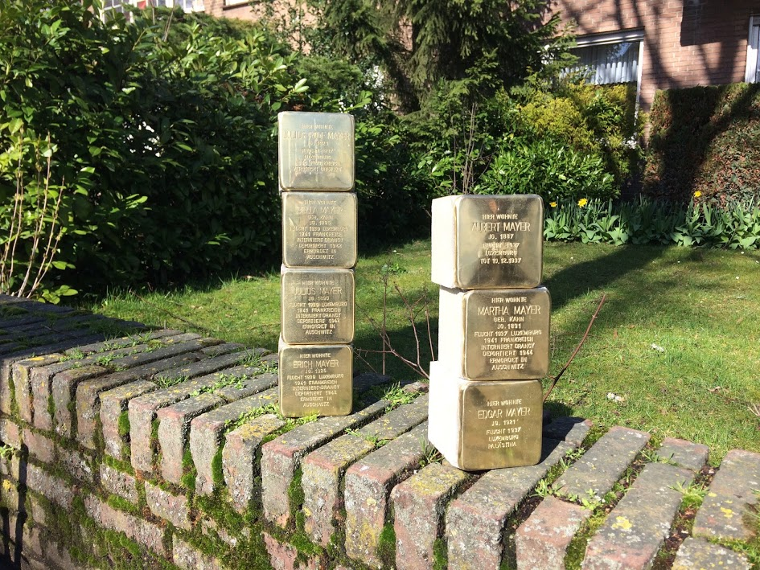
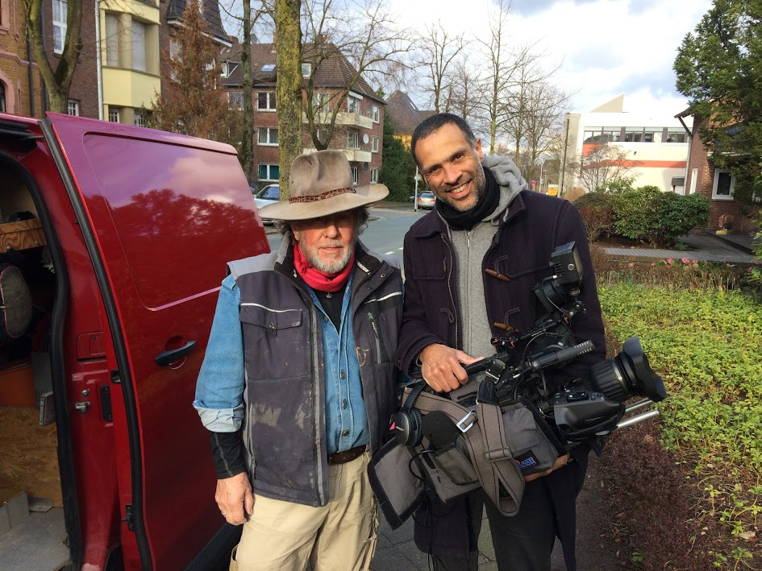
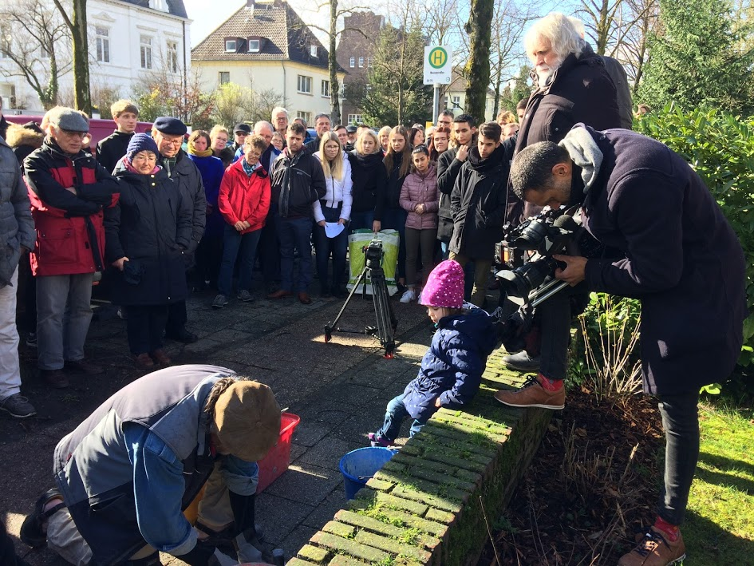
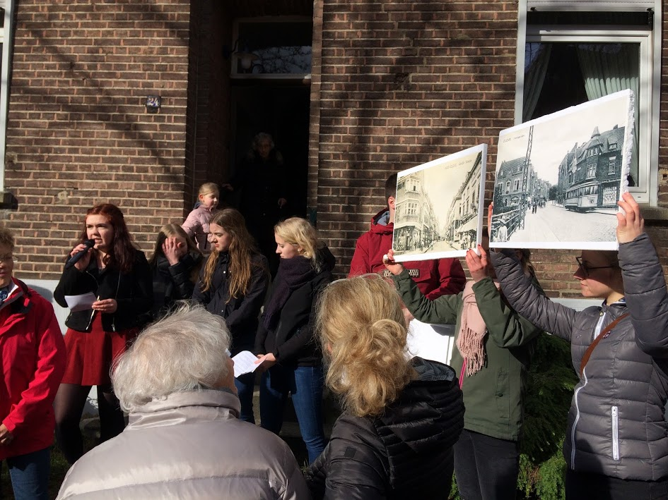
March 17: Kleve, Germany (17 stumbling stones were installed.)

Slide 17
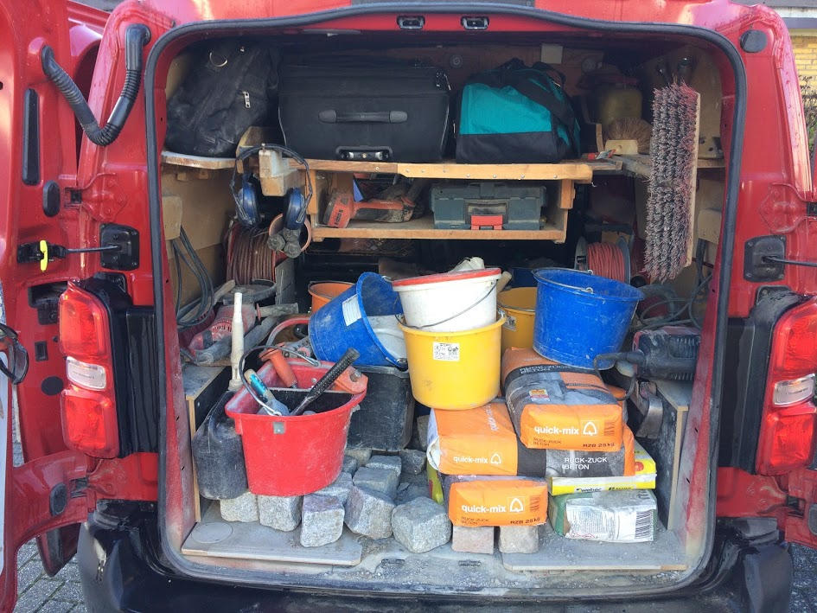
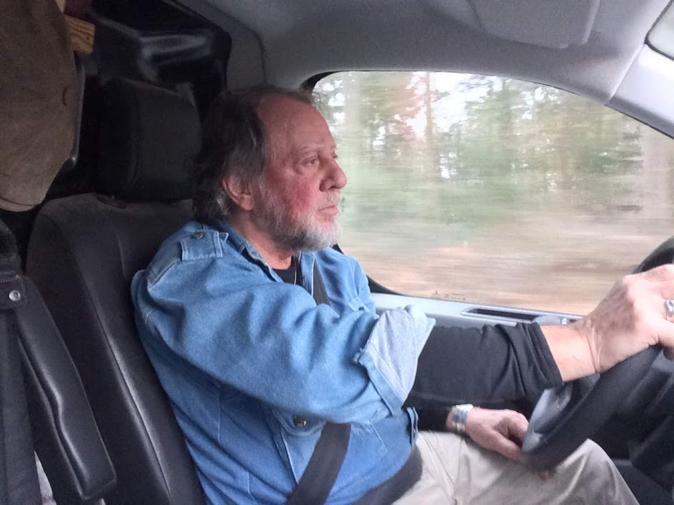
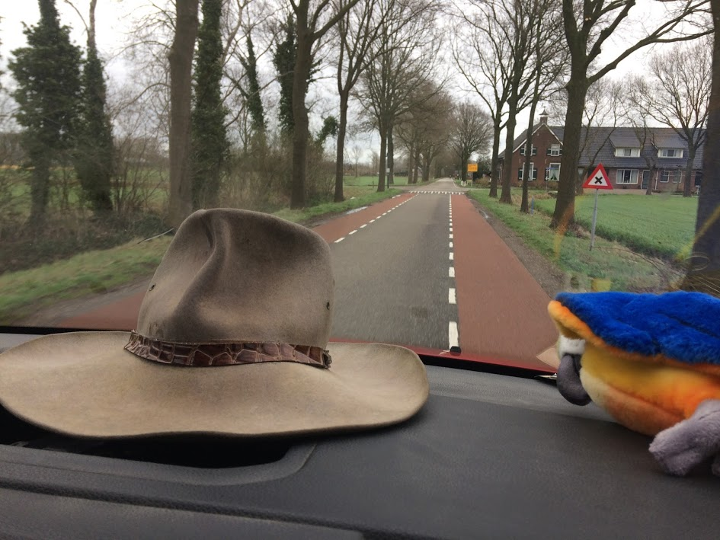
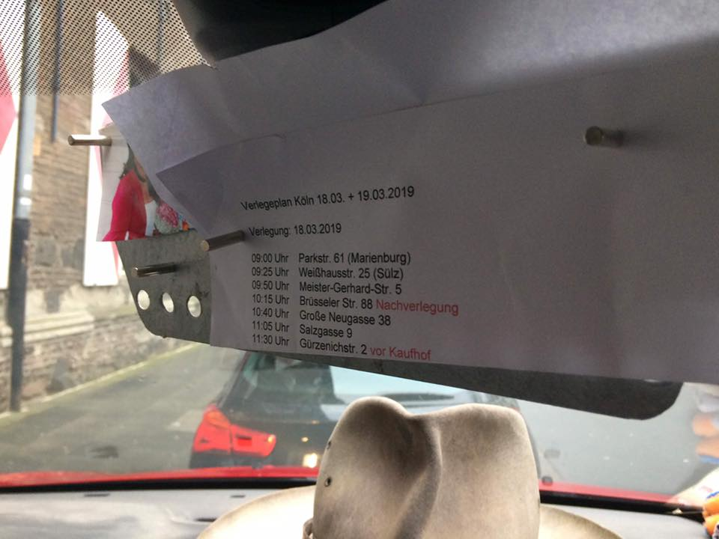
Packing up and going to Cologne

Slide 18
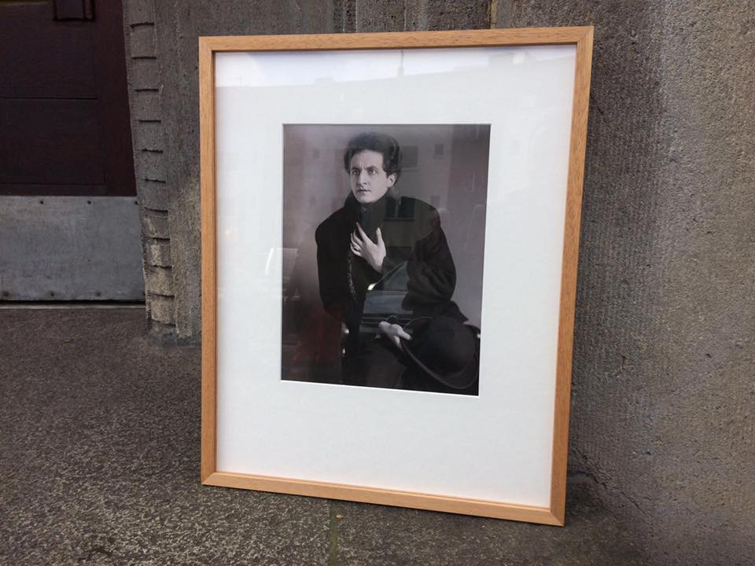
March 18: Cologne, Germany

Slide 19
March 19: Cologne, Germany
Family Helmreich: Herman (1896), Deborah (1896), Joseph (1922), Willi (1925) and Ernst (1929)

Slide 20
March 20: Limburg, Germany

Slide 21
Visiting Anne Frank’s Birthplace (Frankfurt-Aachen-Amsterdam

Slide 22
Stolpersteine: Impressions from a Remembrance Culture

Slide 23
Projects in the US inspired by Demnig’s work
September 2017: 24 Stopping Stones were installed at Philipsburg Manor in Tarrytown, NY, and one at Royall House & Slave Quarters in Medford, MA.
Philipsburg Manor
Royall House & Slave Quarters

Slide 24
Projects in the US inspired by Demnig’s work
November 2017: Three Witness Stones were installed in Guilford, CT: one in front of the Town Hall (“Moses”), one in front of Guilford Savings Bank (“Phyllis”), and one in front of the Hyland House Museum (”Candace”).
Hyland House Museum
Witness Stones

Slide 25
Memorialization in the South
“Only by coming to terms with history can we free ourselves
to create a more just world.” – Drew Gilpin Faust
Sunset Hill Cemetery in Valdosta
Unknown Memorial to the Unknown Slaves
What does the placement say about our ability to come to terms with our history?
How effective can such isolated memorials be?

Slide 26
Memorialization in the South
“Those who cannot remember the past are condemned to repeat it”
George Santayana
Historical Marker for Mary Turner on Hwy 122
Remembering the Lynching Rampage of 1918
What does the placement say about our ability to come to terms with our history?
How effective can such isolated memorials be?
Just a ½ mile away from the marker on Hwy 122:

Slide 27
Can We Benefit from Demnig’s Idea?
The Centrality of Confederate Monuments in Our Communities
Nashville (erected in 2002)
Valdosta (erected in 1911)
“In Honor and Memory of All Confederate Soldiers
Who Defended Our Constitutional Freedom”
“The Principles For Which They Fought Live Eternally”
Nationwide > 700 Confederate monuments and statues overshadow
our ability to remember uncomfortable segments of a shared history

Slide 28
“We cannot heal the deep wounds inflicted during the era of racial terrorism until we tell the truth about it.” Bryan Stevenson, Executive Director, EJI
National Memorial for Peace and Justice
Equal Justice Initiative, Montgomery, Alabama
A national memorial to the > 4,000 victims of lynching in about 20 states
and 800 counties between the end of Reconstruction in 1877 and 1950.
combining centralized & decentralized structures of collective memorialization

Slide 29
Visit to Lynching Memorial in 2018

Slide 30
Remembering the Levy Family in my Hometown
1938 photograph of the Levy family: (Margot, Rosa, Leo, Ferdinand, Liselotte)
Stumbling stones for Ferdinand, Rosa, and Margot
“A person is only forgotten, when his or her name is forgotten.” (Jewish proverb)
Photo of Liselotte and Leo in 1942.
Photograph of Liselotte Levy in 2003
in her house in New Orleans.

Slide 31
How Do We Remember/Honor Victims of Our Past?
Emmett Till (14) and his mother in 1955
We need to individualize and rehumanize victims of our past, to create an integrated culture of remembrance.
In Germany Stolpersteine foster communication about memory as you stumble upon them in the midst of communities. The same could be accomplished by memorials and markers to the victims of our racial violence.
Denial is more difficult in the front of our houses and in the midst of our court house squares.

Slide 32
Competing Narratives in Court House Squares Suggested site for a lynching memorial in Valdosta, on the opposite corner of the court house square where the Confederate monument is located. In reaction to this idea, the sheriff with support of the county’s board of commissioners erected a memorial for the fallen law enforcement officers of Lowndes County. The ground for this memorial was prepared by African-American prisoners from the Lowndes County jail.

Slide 33
Recommended Literature on Stolpersteine
Ben-Asher Gitler, Inbal (Ed.), Monuments and Site-Specific Sculpture in Urban and Rural Space
(Cambridge Scholars Publishing: Newcastle upon Tyne, 2017)
Cook, Matthew Russell, Redefining Memorial Landscapes: The Stolpersteine Project in Berlin
(Masters Thesis, University of Tennessee, 2012)
Harjes, Kirsten, Stumbling Stones: “Holocaust Memorials, National Identity, and Democratic
Inclusion in Berlin” in German Politics and Society (Vol. 23, No. 1, Spring 2005)
Hesse, Hans, Stolpersteine – Idee. Künstler. Geschichte. Wirkung.
(Klartext Verlag: Essen, 2017)
Jordan, Jennifer A., Structures of Memory – Understanding Urban Change in Berlin and Beyond
(Stanford University Press: Stanford, 2006)
Östman, Lars, The Stolpersteine and the Commemoration of Life, Death and Government
(Peter Lang: Bern, 2018)
Till, Karen E., The New Berlin: Memory, Politics, Place
(University of Minnesota Press: Minneapolis, 2005)

